Slide 1


Meson Structure at the EIC
ECCE Diffractive and Tagging WG
May 27th, 2021
Richard Trotta and the meson structure working group

Slide 2
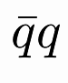
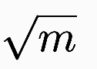
Overview of Pion and Kaon Structure
The pion is both the lightest bound quark system with a valence structure and a Nambu-Goldstone boson
There are exact statements from QCD in terms of current quark masses due to PCAC [Phys. Rep. 87 (1982) 77; Phys. Rev. C 56 (1997) 3369; Phys. Lett. B420 (1998) 267]
From this, it follows the mass of bound states increase as with the mass of the constituents
In contrast (e.g. the CQM), bound state mass rises linearly with constituent mass - in the nucleon m_{Q} ~ ⅓ m_{N} ~ 310 MeV, in the pion m_{Q} ~ ½ m_{𝜋} ~ 70 MeV, in the kaon (with one s quark) m_{Q} ~ 200 MeV (This is not real)
In both DSE and lQCD, the mass function of quarks is the same, regardless of what hadron the quarks reside in (This is real). It is the DCSB that makes the pion and kaon masses light.
Pseudoscalar masses are generated dynamically
Notes:
First bullet-> image: “both show the Sullivan process and the two structure functions accessible”
move to second bullet

Slide 3
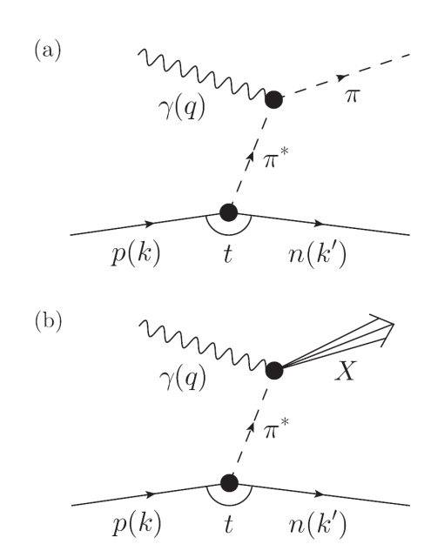
Accessing the Pion and Kaon Structure
At low -t values, the cross-section displays behavior characteristic of meson pole dominance
Using the Sullivan process can provide reliable access to a meson target in this region
Experimental studies over the last decade have given confidence in the electroproduction method yielding the physical pion form factor
Pion cloud can access a) Elastic FF b) PDF
Arlene C. Aguilar, et al., Eur. Phy. J. A (2019) DOI:10.1140/epja/i2019-12885-0
Notes:
First bullet-> image: “both show the Sullivan process and the two structure functions accessible”
move to second bullet

Slide 4
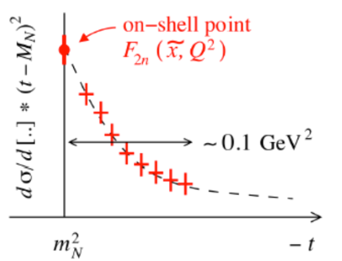
Off-Shell Considerations
The Sullivan process can provide reliable access to a meson target as t becomes space-like
If the pole associated with the ground-state meson remains the dominant feature of the process
the structure of the related correlation evolves slowly and smoothly with virtuality
Recent theoretical calculations found that changes in pion structure are modest so that a well-constrained experimental analysis should be reliable
For the pion when -t ≤ 0.6 GeV²
For the kaon when -t ≤ 0.9 GeV²
S-X Qin, C. Chen, C. Mezrag, C.D. Roberts, Phys. Rev. C 97 (2018) 015203
Notes:
Experimental studies can give confidence the Sullivan process yields the physical pion structure
Theoretical work can give confidence one can extrapolate to the physical pion structure

Slide 5
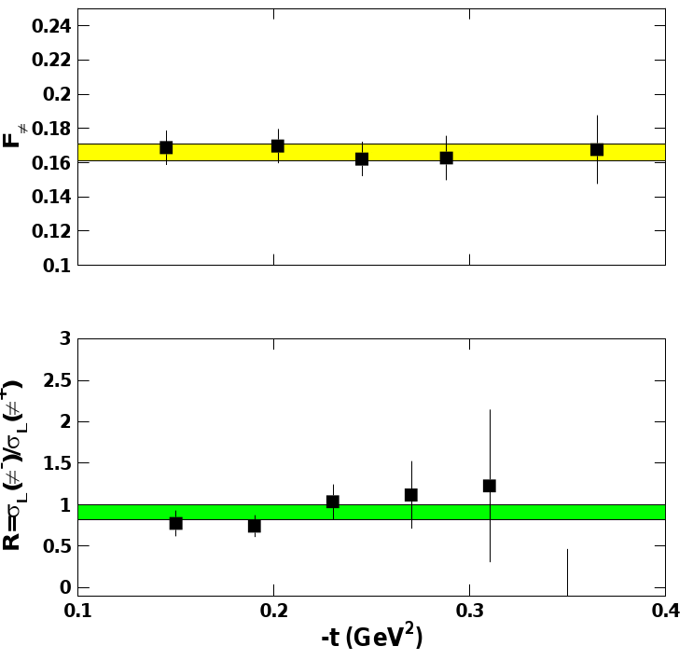
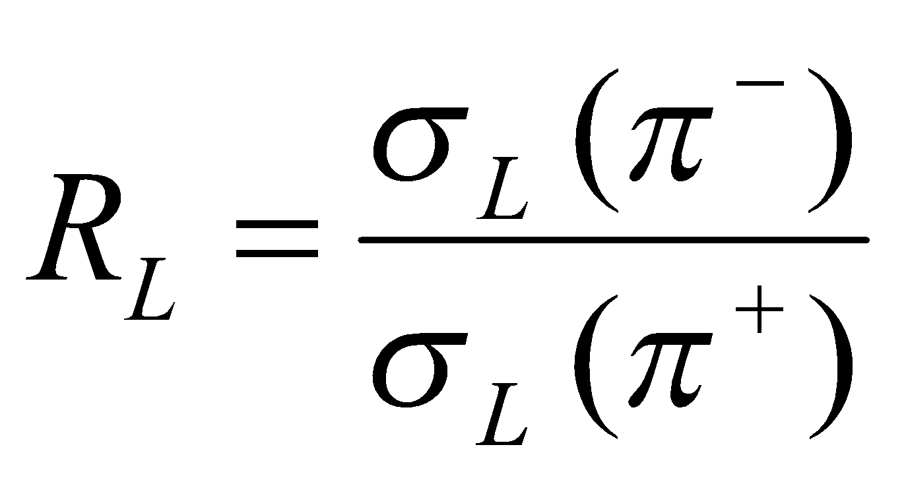
Experimental Validation
F_{π}
To check these conditions are satisfied empirically...
data is taken covering a range in t
compare this data with phenomenological and theoretical expectations
F_{π} values do not depend on -t to give confidence in applicability of model to the kinematic regime of the data
Verify that the pion pole diagram is the dominant contribution in the reaction mechanism
R_{L} (= σ_{L}(π⁻)/σ_{L}(π⁺)) approaches the pion charge ratio, consistent with pion pole dominance
-t [GeV²]
-t [GeV²]
T. Horn, C.D. Roberts, J. Phys. G43 (2016) no.7, 073001
G. Huber et al, PRL112 (2014)182501
R. J. Perry et al., arXiV:1811.09356 (2019)
Notes:
Experimental studies can give confidence the Sullivan process yields the physical pion structure
Theoretical work can give confidence one can extrapolate to the physical pion structure

Slide 6
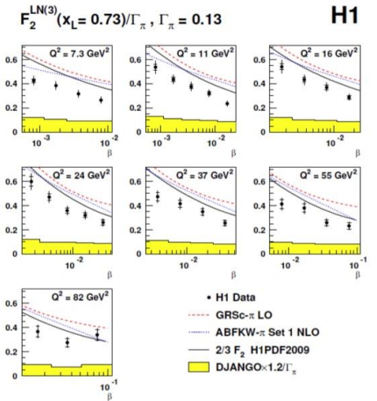
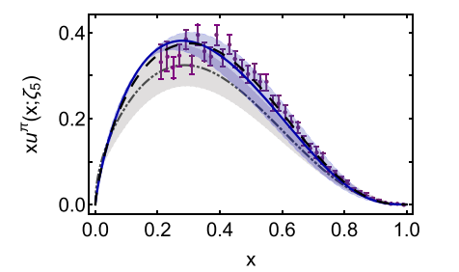
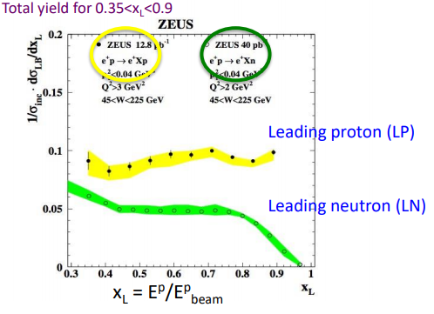
Pion Structure Function Measurements
Knowledge of the pion structure function is very limited…
HERA TDIS data - at low x through Sullivan process (left)
Pionic Drell-Yan from nucleons in nuclei - at large x (right)
One pion exchange is the dominant mechanism
Can extract pion structure function
In practice use in-depth model and kinematic studies to include rescattering, absorption…
DESY 08-176 JHEP06 (2009) 74
Eur. Phy. J. C (2020) DOI:10.1140/epjc/s10052-020-08578-4
Notes:
Experimental studies can give confidence the Sullivan process yields the physical pion structure
Theoretical work can give confidence one can extrapolate to the physical pion structure

Slide 7
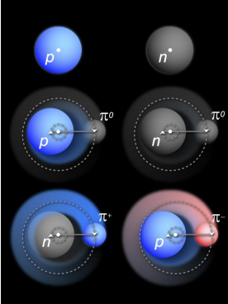
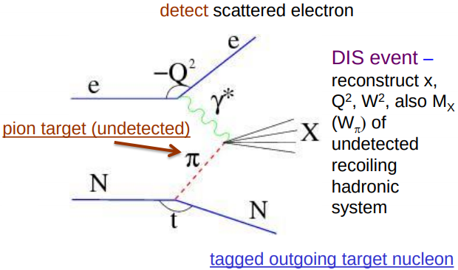
Tagged Deep Inelastic Scattering (TDIS)
Using the Sullivan process – scattering from nucleon-meson fluctuations
Notes:
Experimental studies can give confidence the Sullivan process yields the physical pion structure
Theoretical work can give confidence one can extrapolate to the physical pion structure

Slide 8
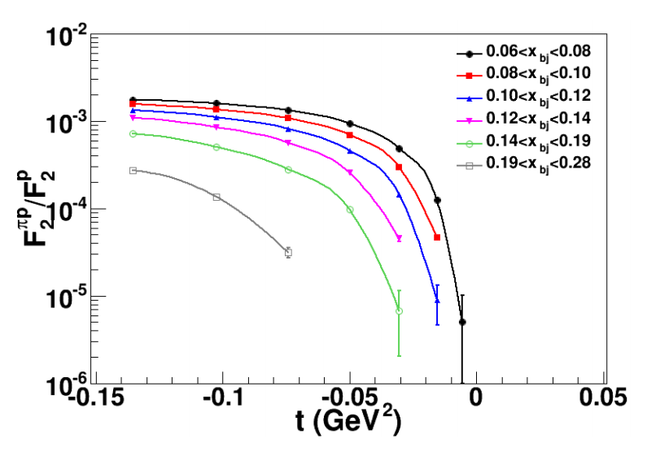
EIC Capabilities
L_{EIC} = 10³⁴ e-nucleons/cm²/s = 1000 x L_{HERA}
Fraction of proton wave function related to pion Sullivan process is roughly 10⁻³ for a small –t bin (0.02)
pion data at EIC should be comparable or better than the proton data at HERA, or the 3D nucleon structure data at COMPASS
By mapping pion (kaon) structure for –t < 0.6 (0.9) GeV², we gain at least a decade as compared to HERA/COMPASS
Consistency checks with complementary COMPASS++/AMBER Drell-Yan data can show process-independence of pion structure information
Jefferson Lab TDIS Collaboration, JLab Experiment C12-15-005 Proposal
Notes:
EIC luminosity is 1000 times that of HERA
Read second bullet ->say “which means”->read sub-bullet
“So by…”-> read third bullet->image: say “Ratio of the SF related to pi Sullivan process compared to proton SF for low t in the vicinity of pion pole”\
“The 1000 times luminosity compared to HERA balances the ratio in various bins of small t. This should allow access to large xpi.”

Slide 9
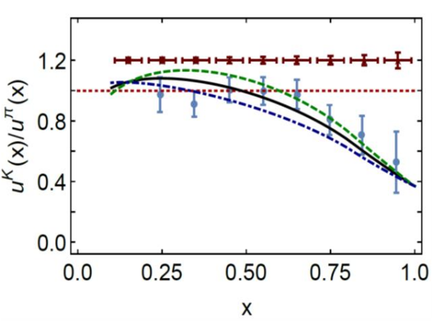
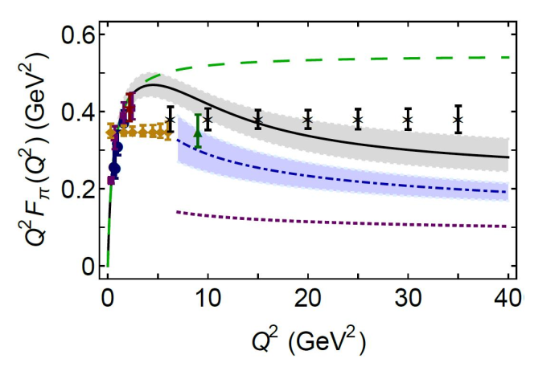
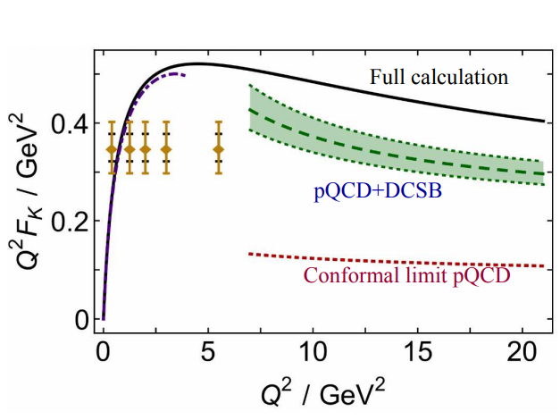
2019 EPJA Pion and Kaon Structure Projections
Projected EIC
The EPJA paper projects a wide range of structure function data
Projected Q² pion FF data up to 35 GeV²
Ratio of valence quark data projected at 1.2
ζ=5.2 GeV
monopole
Projected EIC
pionLT
kaonLT
Arlene C. Aguilar, et al., Eur. Phy. J. A (2019) DOI:10.1140/epja/i2019-12885-0
Notes:
First bullet-
image:(FF->pi/klt)
second bullet->image: (FF->EIC proj)
Third bullet->image: EIC proj

Slide 10
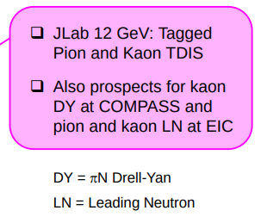
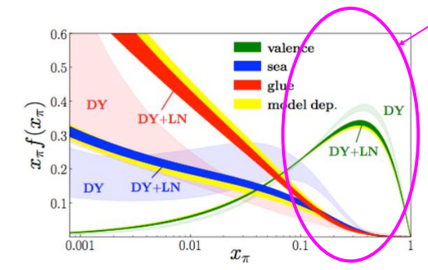
Global Fits: Pion and Kaon Structure Functions
First MC global QCD analysis of pion PDFs
Using Fermilab DY and HERA Leading Neutron data
Significant reduction of uncertainties on sea quark and gluon distributions in the pion with inclusion of HERA leading neutron data
Implications for “TDIS” (Tagged DIS) experiments at JLab
Barry, Sato, Melnitchouk, Ji (2018), Phys. Rev. Lett. 121 (2018) no.15, 152001
Notes:
Experimental studies can give confidence the Sullivan process yields the physical pion structure
Theoretical work can give confidence one can extrapolate to the physical pion structure

Slide 11
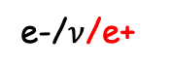
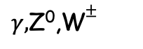
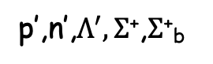
Structure Functions (SF)
Currently implemented
e-/e+
X
For projections use a Fast Monte Carlo that includes the Sullivan process
PDFs, form factor, fragmentation function projections
𝜋⁺, K⁺
𝜋⁰, K⁰, B⁰
Currently implemented
p
Progress with generator development since 2019 EPJA article:
now can make pion structure function (pion SF) projections
Published article in JPhysG (arXiv:2102.11788)
𝜋 structure function: Measure DIS cross section with tagged neutron at small -t
K structure function: Measure DIS cross section with tagged Λ/Σ at small -t
Beam energies: 5 on 41, 5 on 100, 10 on 100, 10 on 135, 18 on 275
Only e-P currently implemented, but want to incorporate e-D

Slide 12
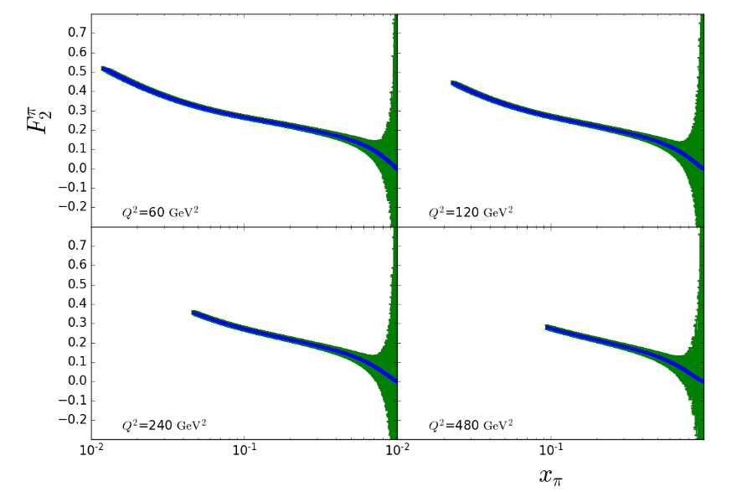
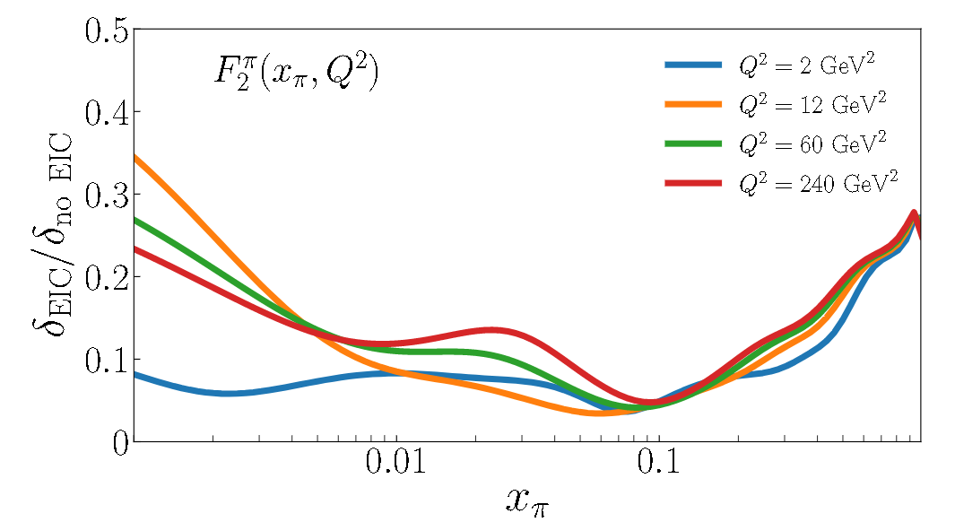
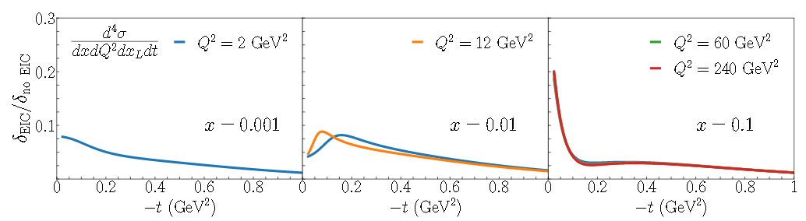
Pion SF Projections
NLO through pion PDFs
Reasonable uncertainties in the mid-to-large x region but increasing rapidly as x→1
Even with these restrictions, the coverage in mid to high x is unprecedented
Access to a significant range of Q² and x, for appropriately small−t
Allows for much-improved insights in the gluonic content of the pion
J Arrington, et al., J. Phys. G (2021) arXiv:2102.11788
Notes:
Experimental studies can give confidence the Sullivan process yields the physical pion structure
Theoretical work can give confidence one can extrapolate to the physical pion structure

Slide 13
𝜋⁺ Form Factors
Exclusive reactions are of interest
p(e,e’𝜋⁺n) exclusive reaction particular with p(e,e’𝜋⁺n)X SIDIS events as the background
A clean sample of p(e,e’𝜋⁺n) events needs to be isolated by detecting the neutron
A difficult measurement to make
Using the events generated from DEMP
EIC software framework can assess the feasibility of the study with updated design parameters
Notes:
Say “looking beyond these studies, the DEMP generator is being used by Uof Regina”
First bullet
Image: say “3 plots of sigmaL vs -t in CKY model for a range of Q2. Blue is Landau function and red is an exponential fit of the CKY points in green.”

Slide 14
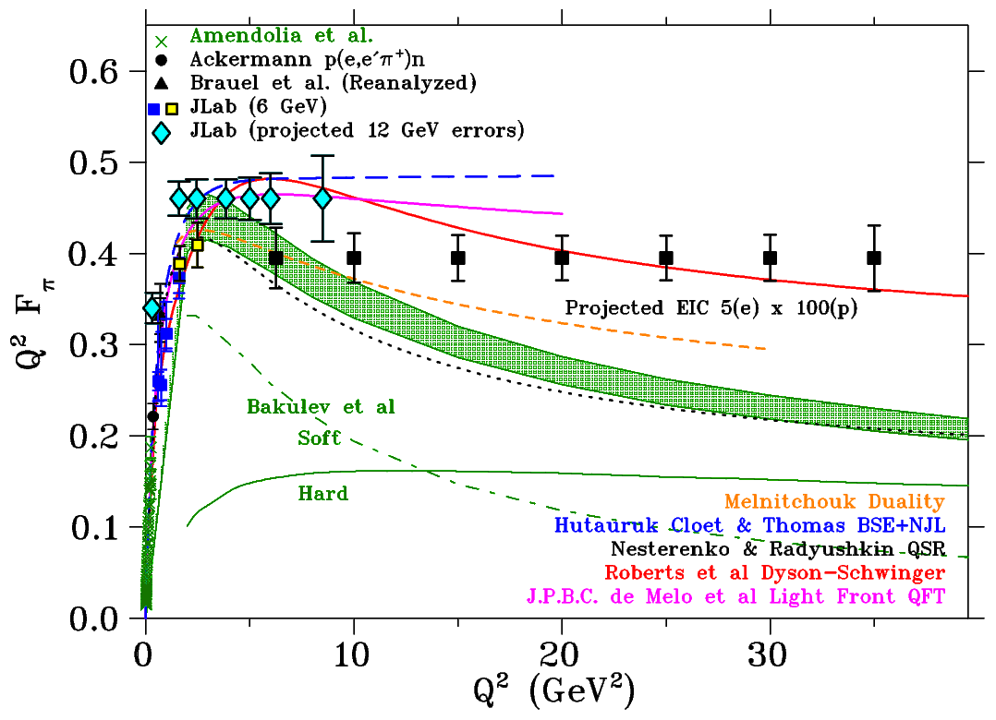
𝜋⁺ Form Factor Projections
Measurements of the p(e,e’𝜋⁺n) reaction at the EIC have the potential to extend the Q² reach of F_{𝜋} measurements even further
Note - y positioning of points arbitrary
Preliminary pion studies featured in the yellow report
Generator modifications for ECCE simulations in progress
Generator will be extended to investigate F_{K} too
Preliminary kaon studies in now in progress
For F_{K}, need to study Σ reconstruction and detection too
Notes:
Say “looking beyond these studies, the DEMP generator is being used by Uof Regina”
First bullet
Image: say “3 plots of sigmaL vs -t in CKY model for a range of Q2. Blue is Landau function and red is an exponential fit of the CKY points in green.”

Slide 15
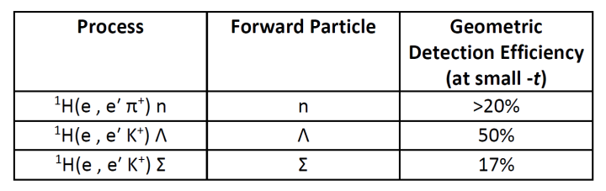
Geometric particle detection fractions
For the pion structure function, the final state neutron moves with an energy near that of the initial proton beam
The Zero Degree Calorimeter (ZDC) must reconstruct the energy and position well enough to constrain both scattering kinematics and 4-momentum of pion
Constraining neutron energy around 35%/√E will assure an achievable resolution in x
For the kaon structure function, the decay products of the Λ must be tracked through the very forward spectrometer
Distinguishing decay products is crucial
Arlene C. Aguilar, et al., Eur. Phy. J. A (2019) DOI:10.1140/epja/i2019-12885-0
Notes:
Say “Empirically what does this mean?”
Say”Two primary cases of intest@
First bullet->(n at large x in particular)
Second bullet->image:(table give confidence in lamda detection at small t)

Slide 16
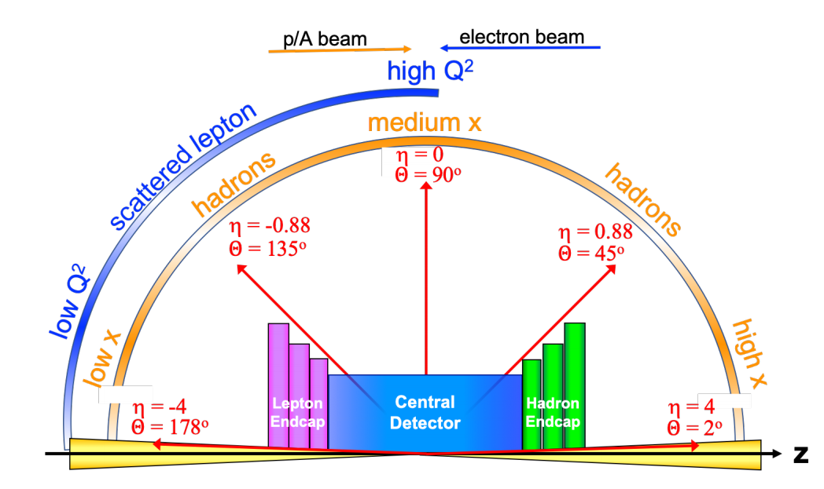
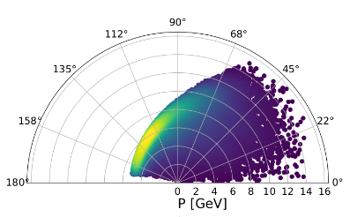
Meson Structure Functions – Scattered Electron
5x41
Scattered electrons can be detected in the central detector

Slide 17
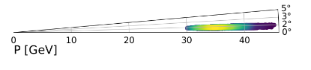
Meson Structure Functions – Forward Baryon
5x41
Baryon (neutron, lambda) at very small forward angles and nearly the beam momentum

Slide 18
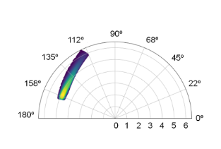
Meson Form Factor - Scattered Electron
5x41
The exclusive electron are stuck to a tighter band

Slide 19
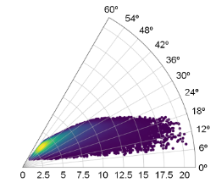
Meson Form Factor - Scattered 𝜋⁺
5x41

Slide 20
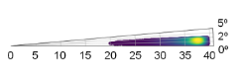
Meson Form Factor - Forward Neutron
5x41
Neutron carries ~80% of the momentum within 0.2º of outgoing proton

Slide 21
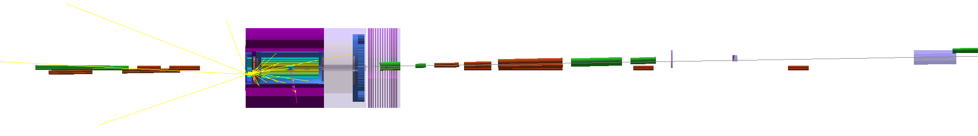
GEANT4 for EIC
Meson structure MC outputs lund files for use in GEANT4
Next goal is to include integration to Fun4All
IP
Roman Pots:
Rin ~ 10σ
20x10 cm²
500x500 um² pixel pitch
Zpos = 26.2 m
Xpos = 82 cm
RP2 (not seen):
Zpos = 28.2 m
Xpos = 91 cm
ZDC:
60x60cm EMCAL
LG: 1x1cm²
HG: 100x100um²
HCAL: 10x10 cm
Zpos = 38 m
Xpos = 90 cm
B0 sensors:
Rin ~ 3.4 cm
Rout ~ 20 cm
50x50 um² pixel pitch
Zpos= 5.9 m
Xpos =15 cm
Off momentum tracker :
Rin ~ 10 *cm (?) ,
10x30cm
500x500 um² pixel pitch
Zpos = 22.5 m
Xpos = 75 cm
Notes:
Off-momentum detector I made larger ( to see acceptance of pi-), the same for Second Roman Pot (RP2) ( not shown at the picture, but just in case, I added a position of this plane too)

Slide 22
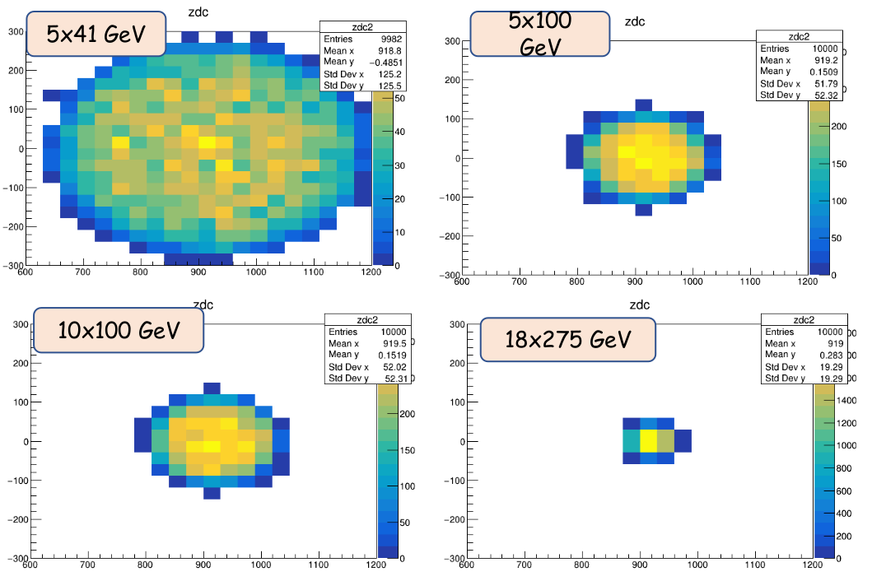
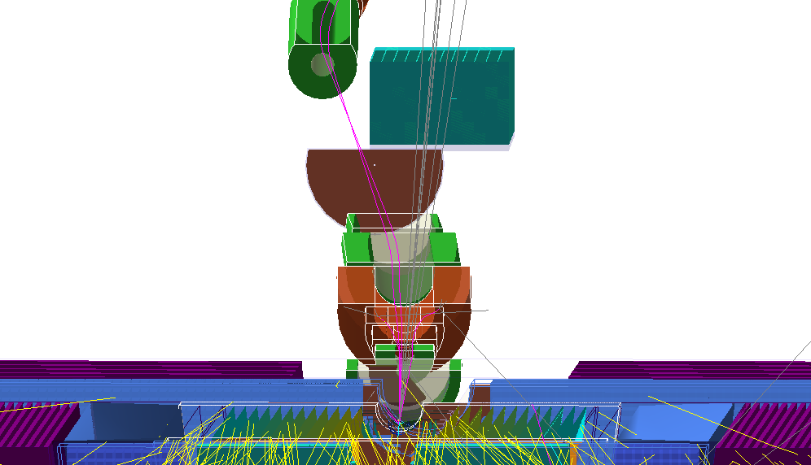
Neutron Final State
For neutron final state use ZDC
detection fractions ~100% for 60x60 cm ZDC size
Need good ZDC angular resolution for required t resolution
n
𝜋
ZDC: [ 60x60 cm, 20 bins → 3 cm towers ]
The 60x60 cm ZDC allows for high detection efficiency for wide range of energies (K-Λ detection benefits from 5 on 41, 5 on 100)
Higher energies (10 on 100, 18 on 275) show too coarse of a distribution at this resolution

Slide 23
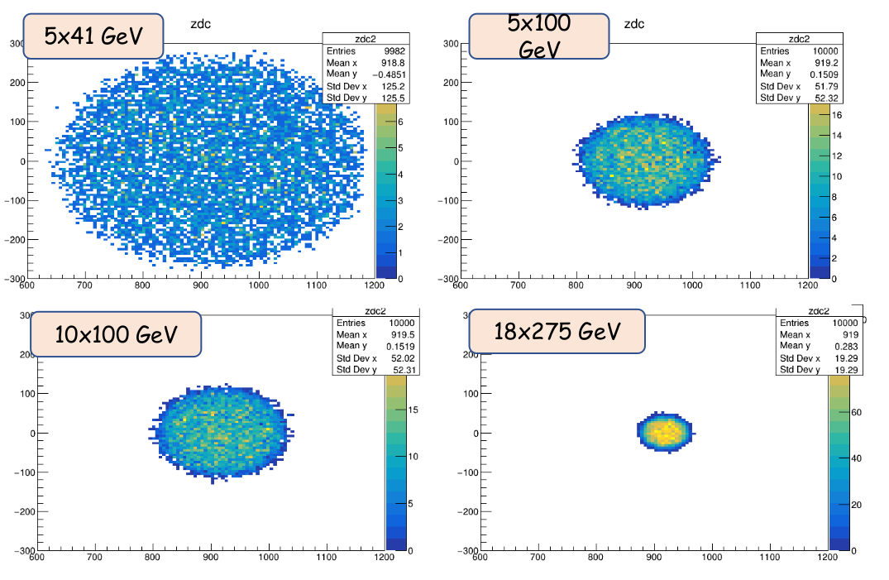
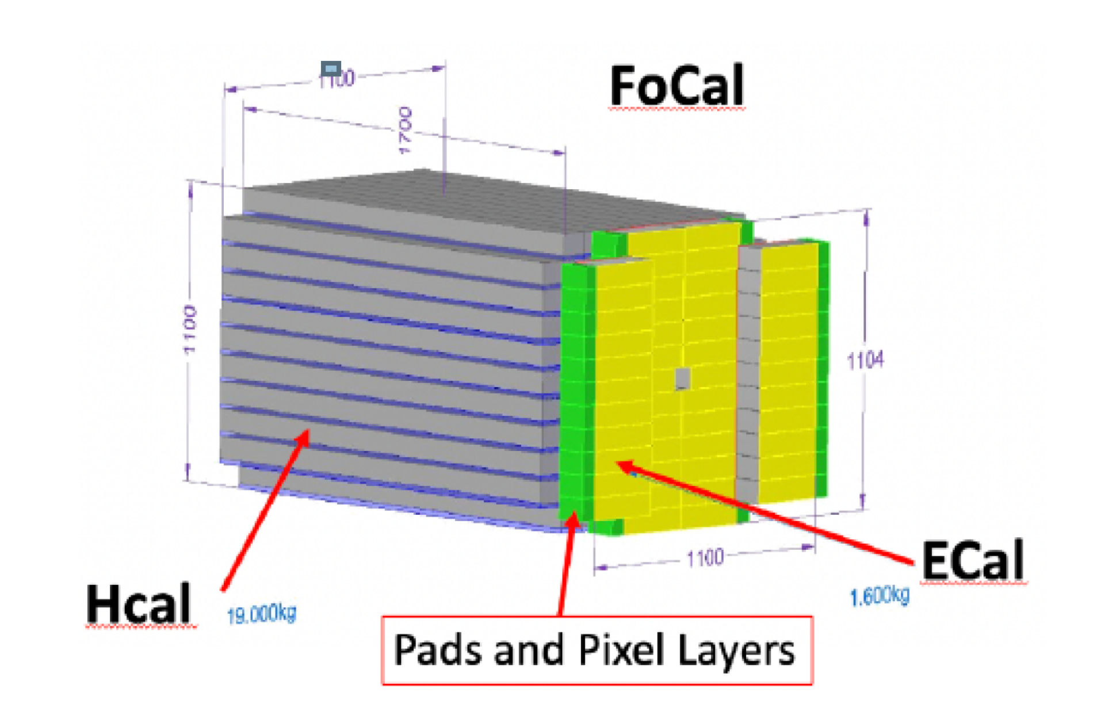
Neutron Final State
For neutron final state use ZDC
detection fractions ~100% for 60x60 cm ZDC size
Need good ZDC angular resolution for required t resolution
ZDC: [ 60x60 cm, 100 bins → 0.6 cm towers ]
If we want energies over 100 GeV, we will need resolution of ~1 cm or better

Slide 24
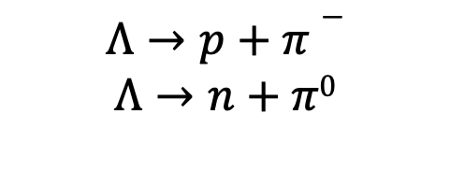
Lambda Final State
Λ has two primary decay modes…
Optimizing the detection efficiency of these decay products is critical for kaon studies
The decay length of Λ is dependent on the initial proton beam energy
Proper choice of this beam energy is a must since decay lengths can reach past the forward spectrometer at higher energies
e-
e-
γ*
X
K⁺
p
Λ
Notes:
Λ at high energy does not decay before forward spectrometer

Slide 25
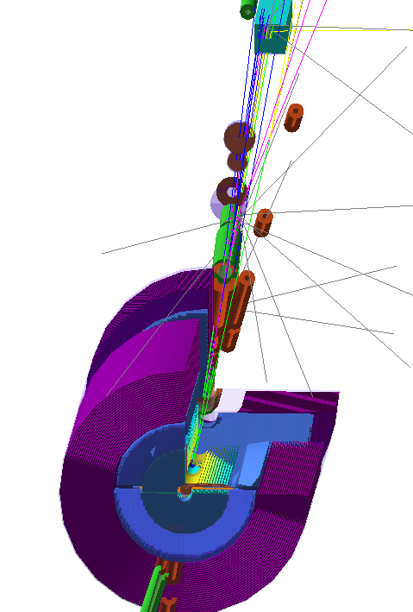
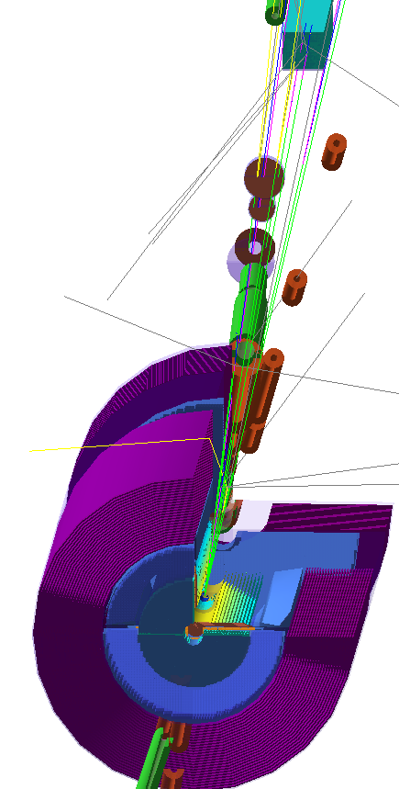
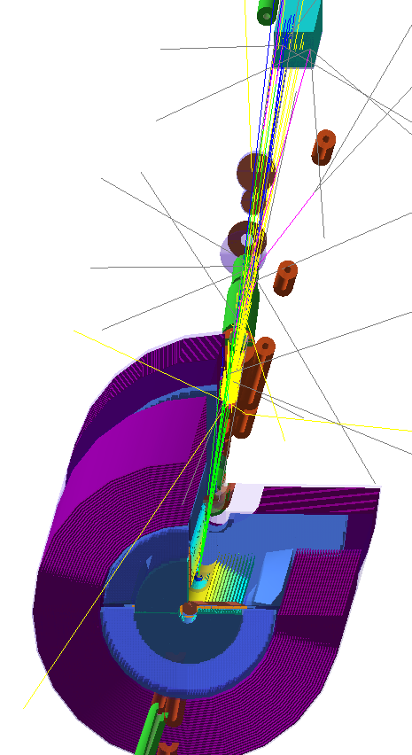
Lambda Final State
30% of Λ at high energy does not decay before forward spectrometer
Neutrons and a fraction of 𝜋⁰ goes into ZDC
𝜋⁻ have opposite charge (bending into other direction from protons)
Protons are detected in the RPs:
18 x 275

Slide 26
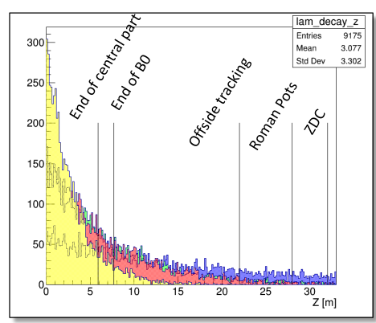
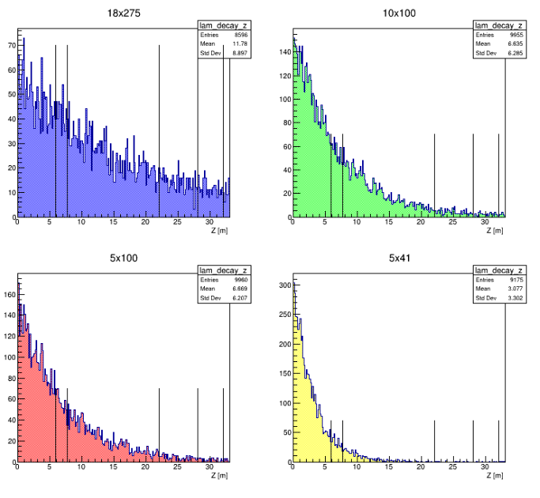
Decay Length
There are some advantages for lower proton energy for K-Λ detection
Notes:
Λ at high energy does not decay before forward spectrometer

Slide 27
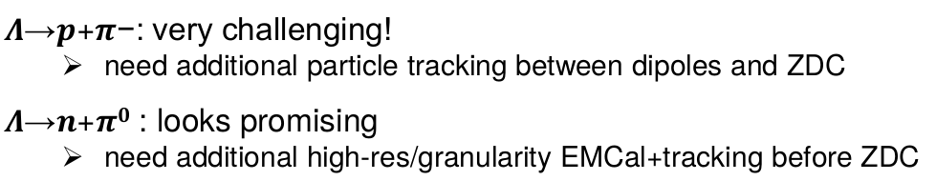
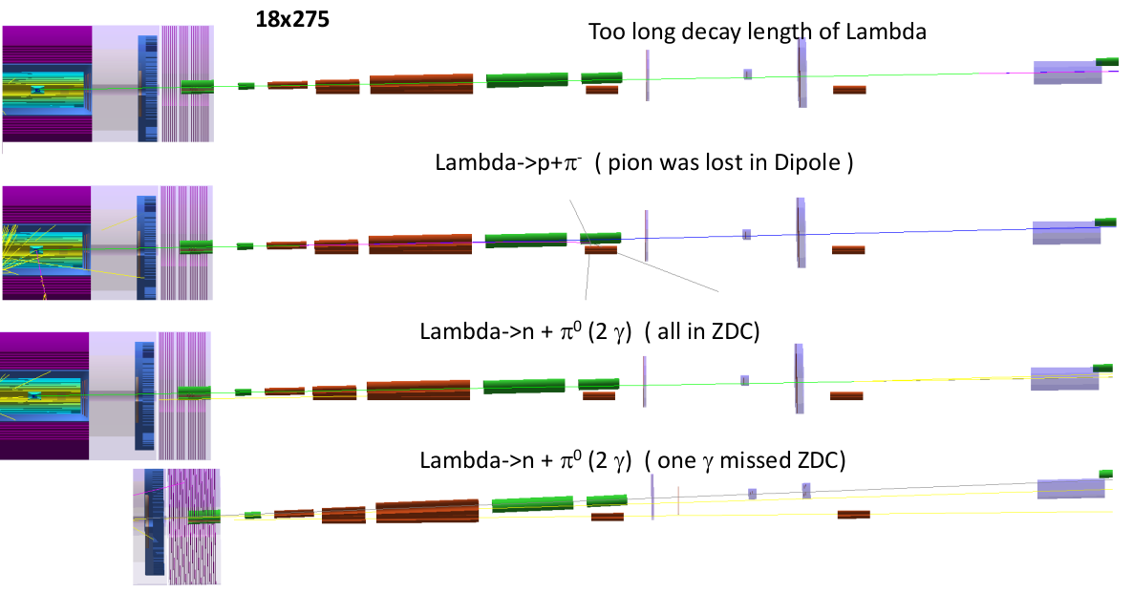
Lambda Final State

Slide 28
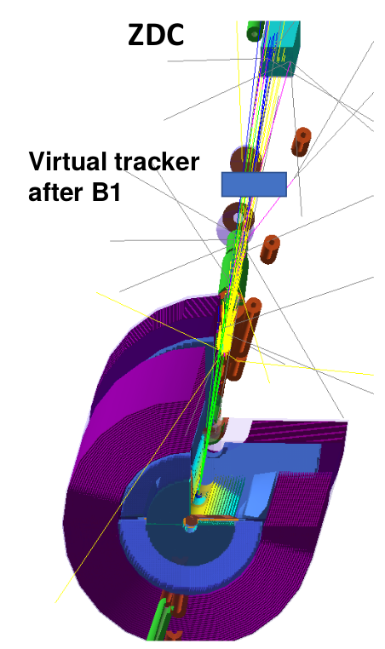
Summary of Detector Requirements
For 𝜋⁺/n...
For all energies, the neutron detection efficiency is ~100% with planned ZDC
Lower energies [5 on 41, 5 on 100], require at least 60cmx60cm size to access wider range of energies
For 𝜋⁺/n and K⁺/Λ…
All energies need good ZDC angular resolution for the required t resolution
High energies [10 on 100, 10 on 135, 18 on 275] require resolution of 1 cm or less
K⁺/Λ benefits from low energies [5 on 41, 5 on 100] and also need…
Λ → n+𝜋⁰ : additional high-res/granularity
EMCal+tracking before ZDC (seems doable)
Λ → p+𝜋⁻ : additional trackers/veto in opposite charge direction on path to ZDC (more challenging)
[In progress] Good hadronic calorimetry to obtain good x resolution at large x
Next goal is a similar analysis for the 2nd IR

Slide 29
Future F₂^{𝜋} projections
Only ZEUS parameterization for F₂^{𝜋} is currently implemented
next step would be checking with other pion SF parameterizations
parameterizations depend on how pion SF is regulated
varying theory inputs for models and checking how they fit MC pseudo-data
Goal is to achieve more comprehensive control/quantification of theory/model uncertainties
explore limitations of Sullivan and single-pion exchange framework
implement additional contributions; e.g., Regge-theoretic modes
these uncertainties are entangled in simulations with the pion structure function (PDF) errors; the combined theory uncertainty must be mapped

Slide 30
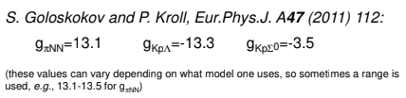
Future F₂^{K} projections
Goal is to extend to tagged kaon structure function
Very limited data on F₂^{K}
Kaon projected structure function data will be of similar quality as the projected pion structure function data for the small-t geometric forward particle detection acceptances at EIC - studies in progress
To determine projected kaon structure function data from pion structure function projections
one method...scale the pion to the kaon case with the coupling constants while taking the geometric detection efficiencies into account
Notes:
For bullet four, note that the coupling constant is only one approach to scale from pion to kaon. There are other and perhaps better ways. No need to change the wording, but someone may comment.

Slide 31
Summary
Full talk at 2020 Pion/Kaon Workshop
Produced initial physics deliverables, physics objects, and kinematic plots/coverage
Physics deliverables: 𝜋/K structure function plots, 𝜋 form factor plot
Physics objects:
scattered electron
Measure 𝜋 and tagged neutron (𝜋 form factor)
Measure “X” and tagged neutron (𝜋 structure function)
Measure “X” and tagged Λ/Σ (K structure function)
Evaluated with simulations detector performance/requirements
Standard detection requirements
For the tagged neutron at all energies: ~100% detection efficiency
Low energies [5 on 41, 5 on 100] require at least 60cmx60cm size to access wider range of energies
High energies [10 on 100, 10 on 135, 18 on 275] requires resolution of 1 cm or less
For measuring the tagged Λ benefits from low energies [5 on 41, 5 on 100] and needs...
Λ → n + 𝜋⁰ : additional high-res/granularity
EMCal+tracking before ZDC (seems doable)
Λ → p + 𝜋⁻ : additional trackers/veto in opposite charge direction on path to ZDC (more challenging)
Next goal is a similar analysis for the 2nd IR and integrate Fun4All framework

Slide 32












Meson structure working group members!
Daniele Binosi , Huey-Wen Lin, Timothy Hobbs, Arun Tadepalli, Rachel Montgomery, Paul Reimer, David Richards, Rik Yoshida, Craig Roberts, Garth Huber, Thia Keppel, John Arrington, Lei Chang, Stephen Kay, Ian L. Pegg, Jorge Segovia, Carlos Ayerbe Gayoso, Bill Li, Yulia Furletova, Dmitry Romanov, Markus Diefenthaler, Richard Trotta, Tanja Horn, Rolf Ent, Tobias Frederico

Slide 33
EXTRA

Slide 34
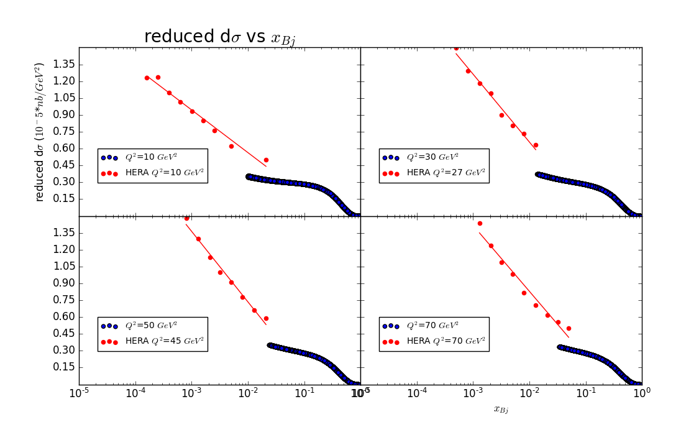
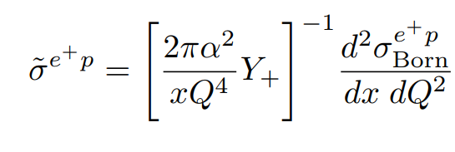
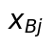
Validation: Reduced cross-section compared with HERA
NEED TO INCREASE SIZE OF LABELS!
HERA data from ZEUS collab, Eur. Phys. J. C 21 (2001) DOI:10.1007/s100520100749
Proton beam = 100 GeV/c
Electron beam = 5 GeV/c
x_{Bj}=(0.01-1.0)
Q²=(10-100)

Slide 35
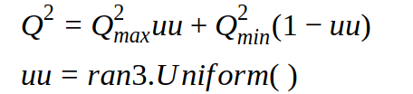



Kinematic Variables

Slide 36


Detection of ¹H(e,e’K⁺)Λ, Λ decay to p + 𝜋⁻
Notes:
This poses main question: how to get decent geometric detection efficiency?

Slide 37


GEANT4 for EIC
Meson structure MC outputs lund files for use in GEANT4
Detector MC updated with eRHIC specifics (crossing angle changes primarily)
Updates to electron beam line
Solenoid centered at zero - this cannot be changed as it affects the beamline
IR region was the same size for JLEIC and eRHIC design, so can use JLEIC detector in eRHIC beam line.
Modulo beam line required changes in end caps, crossing angles

Slide 38


Decay Length [p(e,e’K⁺Λ⁰)X ]
10k events → 3580 neutrons → ~47%
Need to add 𝜋⁰ efficiency
10k events → 6390 protons → ~47%
Need to add 𝜋⁻ efficiency

Slide 39




Virtual planes [p(e,e’K⁺Λ⁰)X ]
Next step: Switch from virtual planes to the real size detector and check detector efficiency
Angular distribution for Proton
Proton
𝜋⁻
X
Z
Y
Virtual planes

